Slide 1
HOUSE PRICES: ADVANCED REGRESSION TECHNIQUES
PROJECT
BY SIMRAN CELLINI

Slide 2
PRESENTATION OUTLINE
Project motivation
Project aim.
Gathering and analyzing my data.
Heatmap
Approach
Data Exploration.
Data Exploration Part 2.
Methodology.
Decision Tree Result
Random Forest Results.
Gradient Boosted Trees Results.
Conclusion

Slide 3
PROJECT MOTIVATION
When researching into this topic I found out the following:
The shortage of homes to buy has caused prices to rise sharply in many areas in the US.
Home prices in New York City have risen 4.1 percent in the past year, still much higher than U.S. average hourly earnings.
Eight out of 10 non-homeowners indicate that owning a home is part of their American Dream.
PROJECT AIM
BASED ON DIFFERENT HOUSE FEATURES CAN WE PREDICT WHAT THE SALE PRICE WILL BE?
Notes:
Estate Agent Evaluation.

Slide 4
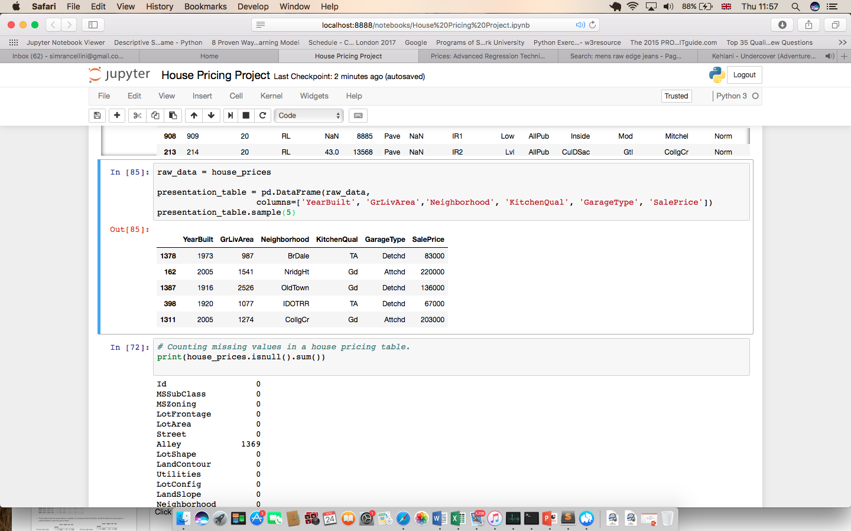
GATHERING & ANALYSING MY DATA
The first step was to gather and analyze my data. The table below shows 5 different types of house features and the output of the project which is the Sale Price. My table has a total 79 different types of house feature.
This is the output that I am trying to predict.
The different house features.
YEAR BUILT: The year when the house was built. KITCHEN QUALITY: The different kitchen quality ratings.
GROUND LIVING AREA: The ground floor living area in square feet. GARAGE TYPE: Whether it is a detached or attached garage.
NEIGHBORHOOD: Different neighborhood locations in the US. SALE PRICE: The property’s sale price in US dollars.

Slide 5
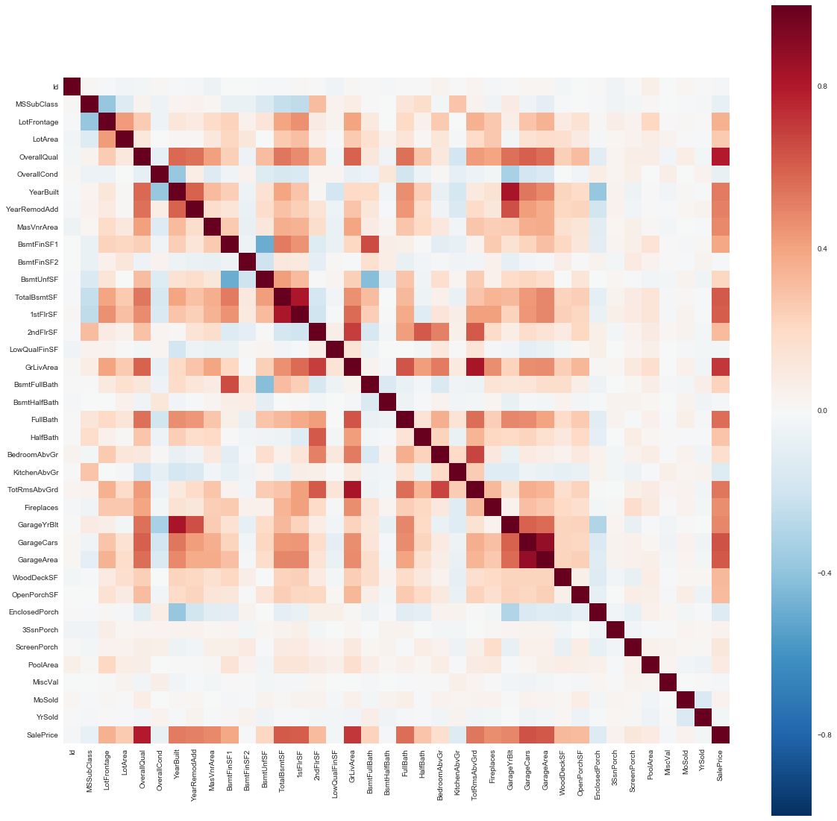
HEATMAP

Slide 6
APPROACH
Inputs were taken from the table.
Model built on the training set to predict what the house sale price will be.
Validate / Test the model on the test set . Explore data to understand which inputs are most important.
Analyse the results.
Notes:
Change Table.

Slide 7
DATA EXPLORATION
In my data exploration stage I created different scatter plots to show how some important features related to the Sale Price.
Ground Living Area
Overall Quality
Notes:
The higher the living area the higher the price.

Slide 8
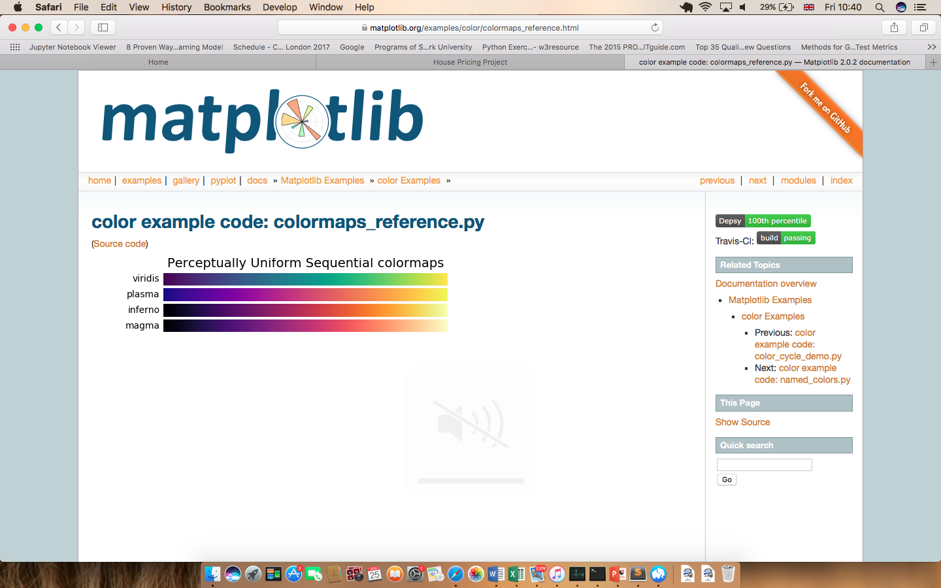
DATA EXPLORATION PART 2

Slide 9
METHODOLOGY
Below are the three machine learning models that I used.
Models
Decision Trees (Makes predictions by choosing one input at a time splitting the data)
Random Forest(By using many decision trees, it takes a random selection of inputs, combines the outputs then takes average of outputs.
Gradient Boosted Trees(Made up of decision trees, each tree is a weak classifier, adds the outputs and then takes the average output.
Evaluation
Regression Output
Root Mean Squared Error over test set.
R2 over the test set (how close you are to
perfect prediction)

Slide 10
DECISION TREE RESULTS
THE ROOT-MEAN SQUARED ERROR = $43596
R2 MODEL SCORE = 0.720

Slide 11
RANDOM FOREST RESULTS
THE ROOT-MEAN SQUARED ERROR = $31395.
R2 MODEL SCORE = 0.854

Slide 12
GRADIENT BOOSTED TREES
THE ROOT-MEAN SQUARED ERROR = $31033.
R2 MODEL SCORE = 0.858

Slide 13
CONCLUSION
To sum up the best models to use were Random Forests and Gradient Boosted Trees. The Root Mean Squared Error for both was around $30,000. It shows that the predictions are more accurate for the lowest house prices.
The machine learning models also showed me what the top ten important features are relating to the Sales Price. Number 1 represents the best model feature.
1. Ground Living Area
2. Overall Quality
3. Lot Area
4. Garage Area
5. Total SF Basement.
6. Overall Condition
7. Year Built
8. Unfinished SF of Basement
9. Type 1 Finished SF
10. Open Porch SF

Slide 14
ANY
QUESTIONS
?

